Slide 1
Histogram Analysis to Choose the Number of Clusters for K Means
By: Matthew Fawcett
Dept. of Computer Science and Engineering
University of South Carolina

Slide 2
Overview
Importance and use
K means cluster algorithm
The changes and adaptation I used
Results
Conclusions and Future Work

Slide 3
Importance
The main reason for use in Medical Imaging is for Segmentation.
Other uses outside of the realms of Image Processing(e.g. information retrieval)
Widespread algorithm

Slide 4
K Means Clustering
Problem is that user doesn’t know the optimal number of clusters to pick.
This is the problem I am trying to solve by using Histogram Analysis.
Histogram of the pixel intensity to find the optimal number of clusters for a picture.

Slide 5
Overview
Importance and use
K means cluster algorithm
The changes and adaptation I used
Results
Conclusions and Future Work

Slide 6
Algorithm
K means clusters is a very simple algorithm
First the user picks the number of centers that he/she would like.
Next the centers are chosen randomly.

Slide 7
Algorithm
I have read on different ways to choose the centers. (e.g. pick the 2 farthest points away from each other.)
After the centers have been established then we check every other point with each of the centers and find the minimum distance.

Slide 8
Algorithm
Each point is assigned to 1 cluster which it is closet.
This makes sense that points that are closer to each other are normally together
After each point is assigned the cluster centers are then recalculated based on these assignments

Slide 9
Algorithm
So once the new centers have been processed the routine starts over and continues until it converges and the centers do not move.
http://www.elet.polimi.it/upload/matteucc/Clustering/tutorial_html/AppletKM.html

Slide 10
Overview
Importance and use
K means cluster algorithm
The changes and adaptation I used
Results
Conclusions and Future Work

Slide 11
The new algorithm
Instead of guessing the number of clusters to have, I have used some preprocessing information to choose the number of clusters.
The first thing to be done is to make a histogram of pixel intensity.

Slide 12
Histogram
The histogram will probably have many peaks and valleys so the idea is to pick the correct number.
My idea was to basically count the peaks on the histogram.
However this can cause problems
Any guesses?

Slide 13
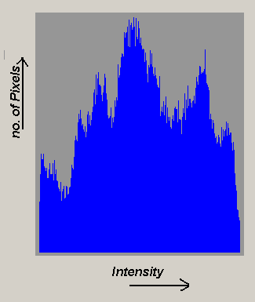
Histogram
Which peaks do I take?

Slide 14
Histogram
I added a term called Threshold.
The threshold term just determines the cutoff point for a peak.
For example: If the threshold is 150 then I only take peaks with 151 or more.
The threshold I chose was the max color which was 255 divided by the number of pixels which equaled to 64.
How about any other problems with a histogram?

Slide 15
Histogram
What about neighboring peaks?

Slide 16
Histogram
I know introduce another term to my work called span.
Span basically covers the number of pixels to the left and right of the current pixel.
For example if span was set to 3 then I would check 3 pixels to the left and 3 pixels to the right and then take the maxmium one over the threshold

Slide 17
Histogram
The span guarantees that I don’t have 2 pixels next to each other as 2 different centers in the picture.
This seems like a reasonable idea because pixels with the same intensity or near same intensity should share the same center and are probably close together.

Slide 18
Find Centers
Based on this information I determine the number of peaks above the threshold and no neighbors based on the span.
This the magic number I am using for the clusters by anglicizing the histogram of the pixel intensity.

Slide 19
Metric
Now I have the number of centers(k)
Start the k means algorithm
Pick k center points at random.
The metric I am using is the difference in intensity. We take the absolute value of this to make sure it positive.
Assign each pixel to one of the clusters

Slide 20
Resign the cluster centers
Now that we have all the pixels in a cluster we recalculate the centers.
Add up each pixel in each cluster and divide by the number of pixels in the cluster and we get the new center.
Supposed to repeat this until it converges but here I just do this 25 times.

Slide 21
Overview
Importance and use
K means cluster algorithm
The changes and adaptation I used
Results
Conclusions and Future Work

Slide 22
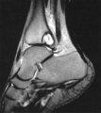
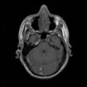
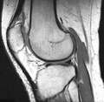
Results
Found some MRI images
Used ImageMagik to change the size of the pictures to be 120 X 120

Slide 23
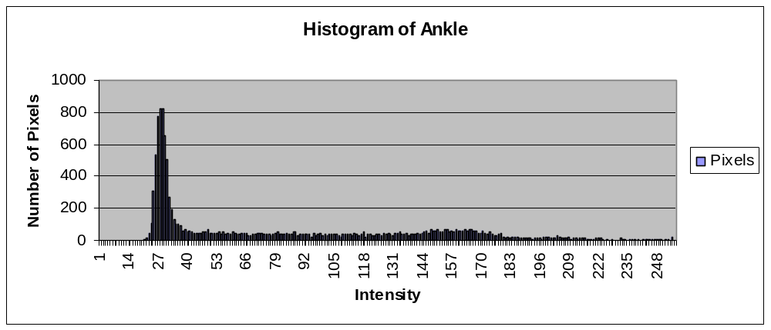
Results
Number of centers = 6

Slide 24
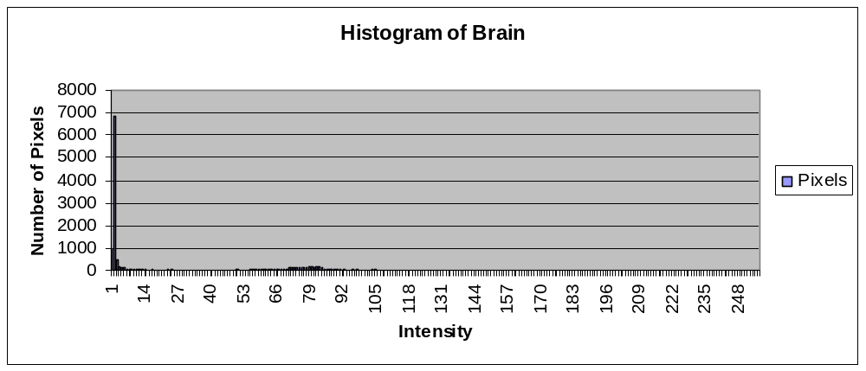
Results
Number of Centers = 19

Slide 25
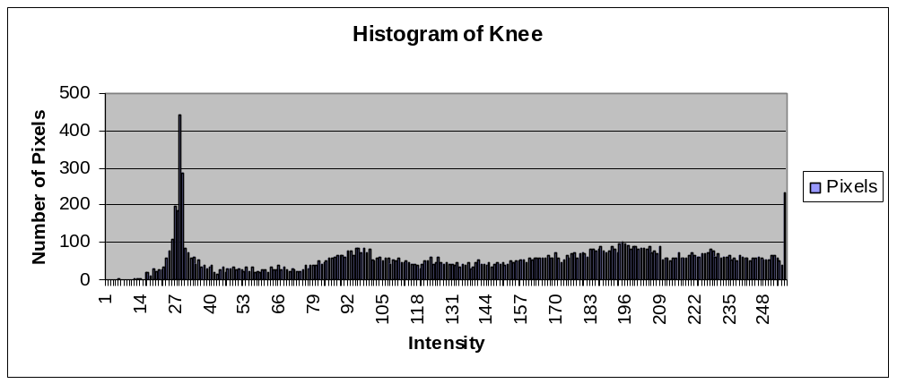
Results
Number of Centers = 17

Slide 26
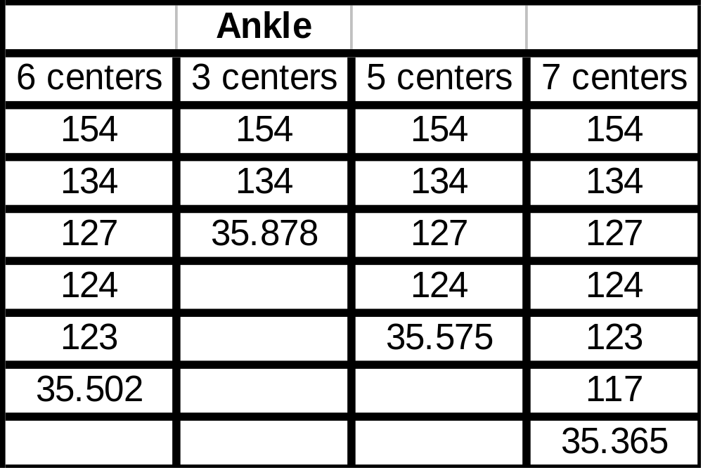
Results

Slide 27
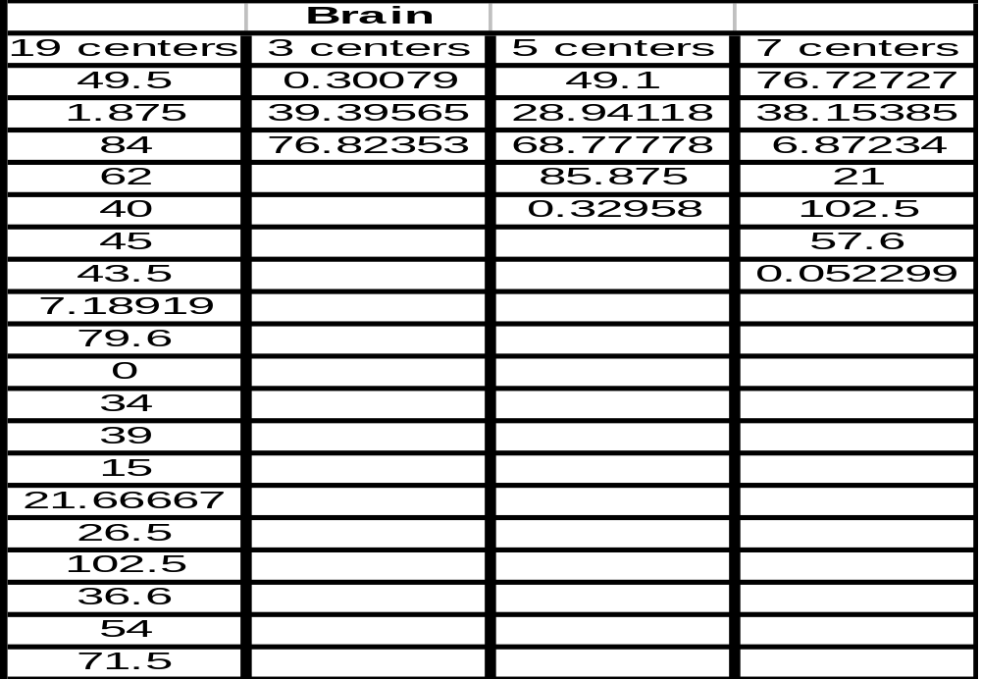
Results

Slide 28
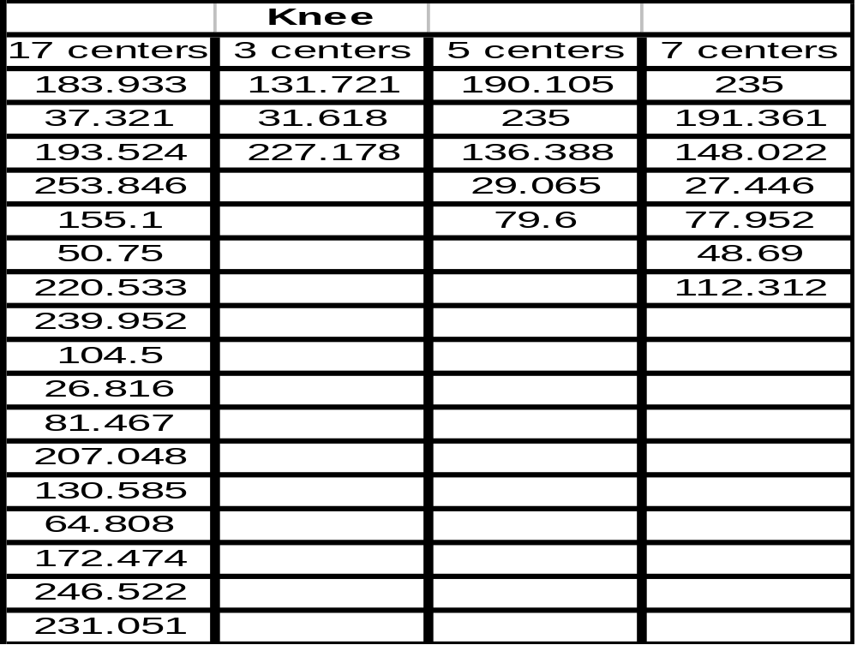
Results

Slide 29
Results
Want to compare the variance of each cluster.
The variance in each cluster should be about the same.

Slide 30
Overview
Importance and use
K means cluster algorithm
The changes and adaptation I used
Results
Conclusions and Future Work

Slide 31
Conclusions and Future Work
A method to find the centers of the clusters
The parameters for threshold and span
Supersampling instead of using just one pixel.

